Slide 1

I gotta have more Data
Team: DROP TABLE teams;--
Jeremy Lassiter, Wes “Tombstone” Sankey, Chris Ballance

Slide 2
Goal
Our goal was to create a simple, repeatable process to find significant factors that may contribute to the long term success without requiring a data scientist or significant technology investment (can be done in a spreadsheet).
Besides, the data was really small.
Notes:
Our goal was to create a simple, repeatable process to find significant factors that may contribute to the long term success without requiring a data scientist or significant technology investment. (Besides, the data is really small. :))
Discover the data, make sure we understand the relationships.
Identify labels and categories
Identify potential safety risks and see if it can be statistically significant (2 records)
We defined success as graduated or support no longer needed.
We found:
-146 positive definitive success.
-272 volunteer moved (neutral - situational)
-Undesirable:
-317 volunteer Lost contact with child/agency
-306 Volunteer: Time constraint
We then tested various attributes to find statistical significance.
We saw significant correlation between volunteer affluent zip codes and the long term success rates.
28269 in particular had a large contribution percentage (15%).
We also saw that 98.63 % were older than 30 for success, where in the failed group younger than 30 climbed to 13.16 %
-- Failure by zip
Select
volzip,
(count(*) /623) as contr_pct
from match_details_old
where
and matchclosurereasons in ('Volunteer: Lost contact with child/agency','Volunteer: Time constraint')
and matchstatus = 'Completed'
group by
volzip
order by (count(*) /623) desc
-- Failure by phase of life
Select
case when volage >= 30 then 'greater than 30' else 'younger' end as 'est_adult',
(count(*) /623) as contr_pct
from match_details_old
where
and matchclosurereasons in ('Volunteer: Lost contact with child/agency','Volunteer: Time constraint')
and matchstatus = 'Completed'
group by
case when volage >= 30 then 'greater than 30' else 'younger' end
order by (count(*) /623) desc
-- Success by zip
Select (count(*)/146) as contrib_pct , volzip
from match_details_old
where
and matchstatus = 'Completed'
and matchclosurereasons in ('Child: Graduated','Strong Relationship: Support No Longer Needed')
group by volzip
order by (count(*)/146) desc
-- Success by phase of life
Select (count(*)/146) as contrib_pct ,
case when volage >= 30 then 'greater than 30' else 'younger' end as 'est_adult'
from match_details_old
where
matchstatus = 'Completed'
and matchclosurereasons in ('Child: Graduated','Strong Relationship: Support No Longer Needed')
group by
case when volage >= 30 then 'greater than 30' else 'younger' end
order by (count(*)/146) desc

Slide 3
Process
Discover the data, make sure we understand the relationships. Identify labels and categories
Identify potential safety risks and see if it can be statistically significant (2 records)
We defined success as having graduated or support no longer needed.
Other criteria could be used such as a weighting across the length of relationship, but we chose to keep the criteria tighter, to highlight the most glaring contributing factors.

Slide 4
Givens:
317 Volunteer Lost contact w/ child/agency 306 Volunteer: Time constraint
146 met the criteria for success. 272 volunteer moved (neutral - situational)
We then tested various attributes for significance.
This does not require significant tooling.
We also chose to simply display the contribution percentage within a group.
Notes:
Select state, a.volzip, obs, expected, power((obs - expected),2)/expected as chisq
from
(
Select 'success' as 'State',
count(*) as obs , volzip
from match_details_old where
matchclosurereasons not like '%safety%'
and matchstatus = 'Completed' and matchclosurereasons in ('Child: Graduated','Strong Relationship: Support No Longer Needed')
group by volzip
union all
Select 'failure' as 'State',
count(*) as obs , volzip
from match_details_old
where
matchclosurereasons not like '%safety%'
and matchclosurereasons not in ('Child: Graduated','Strong Relationship: Support No Longer Needed','Child/Family: Moved')
and matchclosurereasons in ('Volunteer: Lost contact with child/agency','Volunteer: Time constraint')
and matchstatus = 'Completed'
group by volzip
) a
inner join
(
Select sum(obs) as expected, volzip
from
(
Select 'success' as 'State',
count(*) as obs , volzip
from match_details_old where
matchclosurereasons not like '%safety%'
and matchstatus = 'Completed' and matchclosurereasons in ('Child: Graduated','Strong Relationship: Support No Longer Needed')
group by volzip
union all
Select 'failure' as 'State',
count(*) as obs , volzip
from match_details_old
where
matchclosurereasons not like '%safety%'
and matchclosurereasons not in ('Child: Graduated','Strong Relationship: Support No Longer Needed','Child/Family: Moved')
and matchclosurereasons in ('Volunteer: Lost contact with child/agency','Volunteer: Time constraint')
and matchstatus = 'Completed'
group by volzip
) a
group by volzip desc
) c on c.volzip = a.volzip

Slide 5
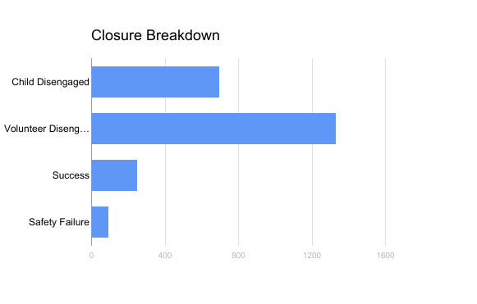
Four Primary Scenarios
Successes
Strong relationship
Child graduated
Match successful
Safety Issue
Infraction of rules
Concern for child safety
Volunteer Disengagement
Child Disengagement

Slide 6
Biggest Problem: Volunteer Disengagement
Can we find common trends amongst volunteers who disengage?
Most common occupation: banking
Education level: bachelors and masters degree
Marital status: single
Are these attributes exclusive towards those who disengage? Not entirely.
Success scenario had similar breakdown

Slide 7
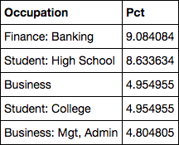
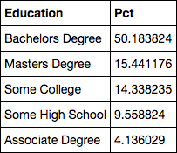
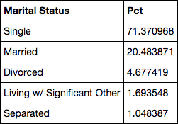
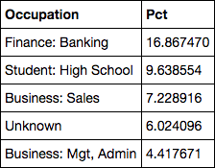
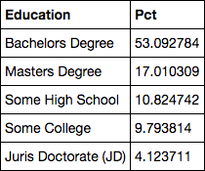
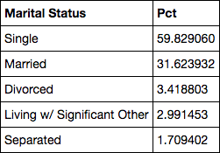
Comparison of Attributes

Slide 8
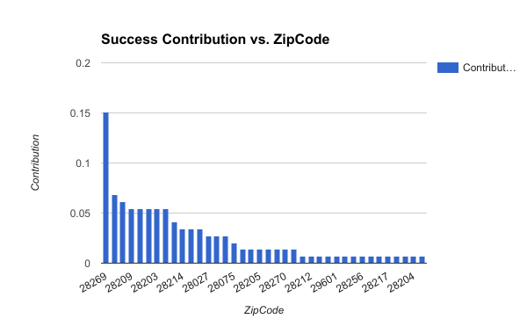
Correlation between success and volunteer zip code
We saw significant correlation between volunteer zip codes and the long term success rates.
28269 in particular had a large contribution percentage (15%) within the success group..

Slide 9
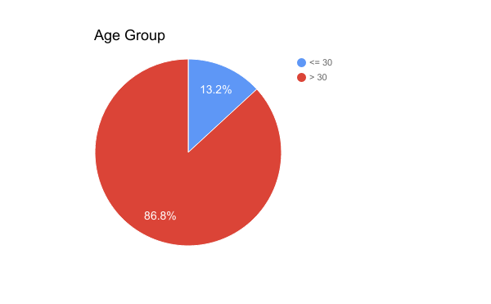
Other significant attributes: volunteer age
We also saw that 98.63 % were older than 30 for success, where in the failed group younger than 30 climbed to 13.16 %

Slide 10
Appendix
Reference queries

Slide 11
Simple queries for proofs - success by zip
--Total count of success is a constant 146 Select (count(*)/146) as contrib_pct , volzip from match_details_old where and matchstatus = 'Completed' and matchclosurereasons in ('Child: Graduated', 'Strong Relationship: Support No Longer Needed') group by volzip order by (count(*)/146) desc
Notes:
-- Failure by zip
Select
volzip,
(count(*) /623) as contr_pct
from match_details_old
where
and matchclosurereasons in ('Volunteer: Lost contact with child/agency','Volunteer: Time constraint')
and matchstatus = 'Completed'
group by
volzip
order by (count(*) /623) desc

Slide 12
Simple queries for proofs - success by age group
--Total count of success is a constant 146 Select (count(*)/146) as contrib_pct , case when volage >= 30 then 'greater than 30' else 'younger' end as 'est_adult' from match_details_old where matchstatus = 'Completed' and matchclosurereasons in ('Child: Graduated', 'Strong Relationship: Support No Longer Needed') group by case when volage >= 30 then 'greater than 30' else 'younger' end order by (count(*)/146) desc

Slide 13
Simple queries for proofs - failure by age group
-- Total count of failure is a constant 623 Select case when volage >= 30 then 'greater than 30' else 'younger' end as 'est_adult', (count(*) /623) as contr_pct from match_details_old where and matchclosurereasons in ('Volunteer: Lost contact with child/agency',' Volunteer: Time constraint') and matchstatus = 'Completed' group by case when volage >= 30 then 'greater than 30' else 'younger' end order by (count(*) /623) desc

Slide 14
Simple queries for proofs - failure by zip
-- Total count of failure is a constant 623 Select volzip, (count(*) /623) as contr_pct from match_details_old where and matchclosurereasons in ('Volunteer: Lost contact with child/agency', 'Volunteer: Time constraint') and matchstatus = 'Completed' group by Volzip order by (count(*) /623) desc

